Slide 1
Introduction to Machine Learning

Slide 2
What is Machine Learning?
Machine learning: using algorithms to build models and generate predictions from data
Contrast to what we’ve learned in stats classes, where the user specifies a model

Slide 3
Why Use It?
Where accurate prediction matters more than causal inference
To select variables where there are many possibilities
To learn about the structure of the data and new variables
Robustness check

Slide 4
The ML Family
Machine learning is a field with many different methods
We’ll explore a few that have clear applications in the social sciences

Slide 5
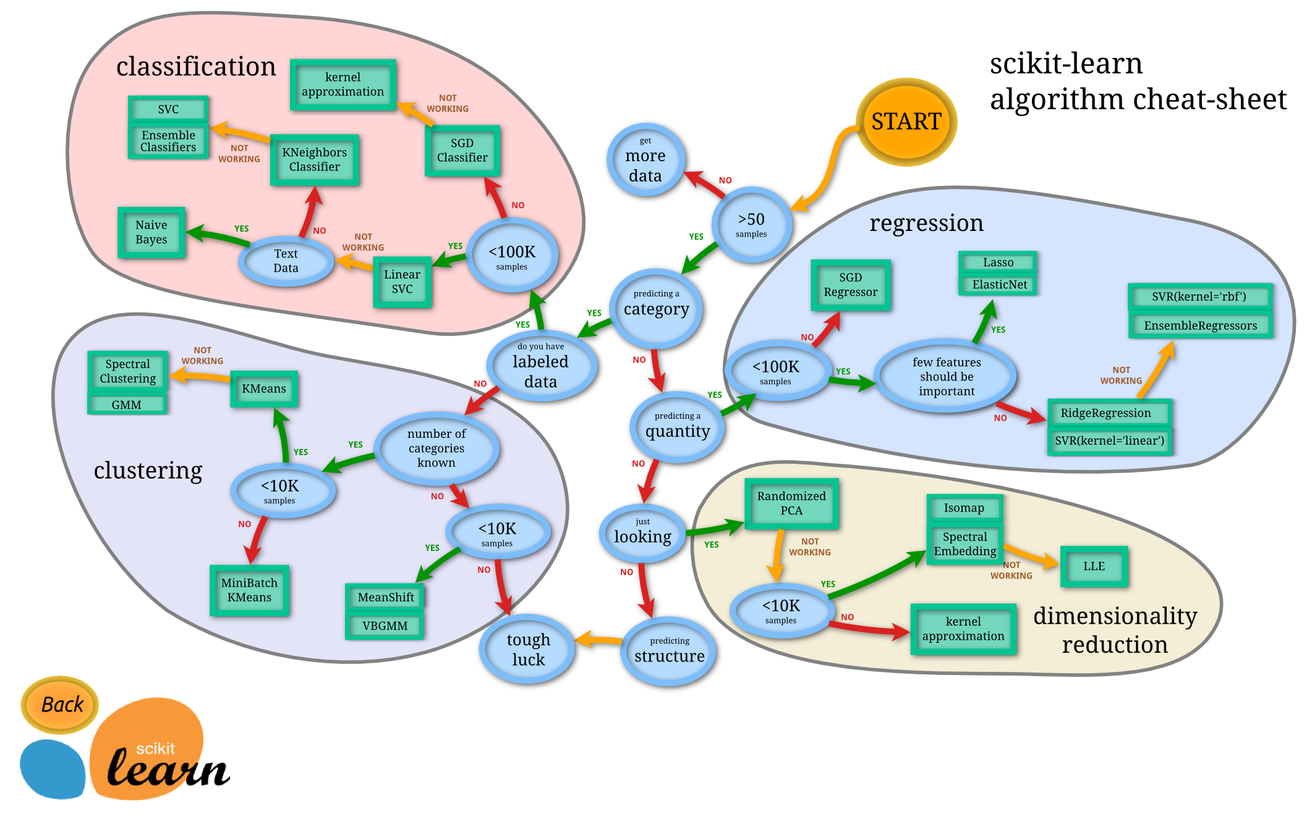
Choose your own adventure!

Slide 6
We’ll look at:
Cross-validation and parallelization (not strictly ML, just useful)
CART
Random forests
Honorable mentions: lasso, KNN, and neural networks.

Slide 7
Parallelization
You can split repetitive processes into batches and parcel them out to your computer’s cores
Cuts down on run time and is an efficient use of computing power
Many options for doing this in R; some packages make it really easy

Slide 8
Cross-validation
Partitioning and/or resampling your data to create a model with one subset and evaluate it with another
Point: limits overfitting

Slide 9
K-fold cross-validation
We will use 10-fold cross validation
We randomly split the data into 10 subsets
We train the model on 9 of those and evaluate its predictive strength on the 10th

Slide 10
Lab Section 1: Setting things up

Slide 11
Classifiers
CART, KNN, and random forests are all classifiers
They “learn” patterns from existing data, create rules or boundaries, and then make predictions about which group a given data point belongs to
They are all supervised learning: you tell the algorithm what you want and give it examples

Slide 12
CART: Decision Trees
Classification And Regression Trees
Partition the data into increasingly small segments in order to make a prediction
Find optimal splits in the data
The basis for random forests

Slide 13
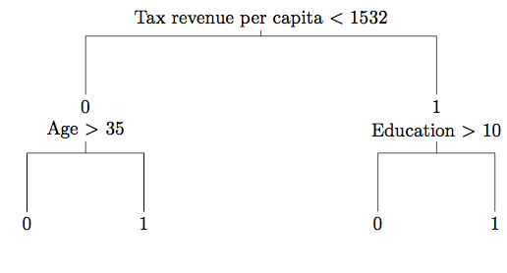
Example CART

Slide 14
Lab Section 2: Make a CART

Slide 15
Random Forests
Supervised ensemble method
Relies on bootstrap aggregating or bagging
Tree bagging: learning a decision tree on a random sample of training data
Random forests adds an additional step by randomizing the variables evaluated at each node

Slide 16
Random Forests
A random forests classifier grows a forest of classification trees
The classifier randomly samples variables at the nodes of the tree; trees uncorrelated
The classifier then combines the predictions
Note: can also be used with regression

Slide 17
Random Forests
At each node in each tree, the classifier finds the optimal split that best separates the remaining data into homogenous groups
A split can be a number, a linear combination, or a classification
This recursive partitioning process generates classification rules

Slide 18
Lab Section 3: Random Forests and Post-Estimation

Slide 19
Advanced Topics
Unsupervised learning and neural nets
Feature selection
Doing this in Python
Causal inference with machine learning

Slide 20
Resources
Muchlinski, David, David Siroky, Jingrui He, and Matthew Kocher. "Comparing Random Forest with Logistic Regression for Predicting Class-Imbalanced Civil War Onset Data." Political Analysis 24, no. 1 (2016): 87-103. (excellent and helpful replication files)
Breiman, Leo. "Random forests." Machine learning 45.1 (2001): 5-32.
Breiman, Leo. "Statistical modeling: The two cultures (with comments and a rejoinder by the author)." Statistical science 16.3 (2001): 199-231.
Grimmer, Justin. "We are all social scientists now: how big data, machine learning, and causal inference work together." PS: Political Science & Politics 48.01 (2015): 80-83.
Conway, Drew, and John White. Machine learning for hackers. " O'Reilly Media, Inc.", 2012.
Notes:
Adele Cutler helped developed random forests. Unfortunately, the articles were single author.

Slide 21
Free Online Classes and Tutorials
DataCamp Machine Learning for Beginners: https://www.datacamp.com/courses/machine-learning-toolbox
Udacity machine learning class: https://www.udacity.com/course/intro-to-machine-learning--ud120
kNN example in R: https://www.r-bloggers.com/using-knn-classifier-to-predict-whether-the-price-of-stock-will-increase/

